Slide 1
AMAZON PRODUCTS REVIEW ANALYSIS

Slide 2
INTRODUCTION
In today’s digital marketplace, customer reviews are a powerful tool that influences purchasing decisions. Amazon, being one of the largest e-commerce platforms in the world, collects millions of product reviews from users. These reviews provide valuable insights into customer satisfaction, product quality, and user experience.
Amazon Product Review Analysis involves examining this large volume of textual and numerical data to uncover meaningful patterns. By analyzing metrics such as star ratings, helpful votes, and review frequency over time, businesses and researchers can:
Understand customer sentiment.
Detect product issues or improvements.
Track trends in consumer behavior.
Improve product offerings and marketing strategies.
This analysis not only helps companies enhance their products but also assists consumers in making informed decisions based on genuine user experiences.

Slide 3
Dataset Overview: Amazon Product Reviews
The dataset used for this analysis consists of Amazon product reviews, containing both numerical and textual information related to customer feedback. Key columns include the overall rating (overall), written review text (reviewText), a short summary of the review (summary), the time the review was posted (unixReviewTime), and helpfulness votes (helpful). To prepare the data for analysis, missing values in critical fields like overall and unixReviewTime were removed, while missing text fields were filled with empty strings. Duplicate entries were also dropped to maintain data integrity. The helpful column, originally stored as a list, was split into two new columns: helpful_votes and total_votes, making it easier to analyze review influence. Additionally, a new column reviewYear was derived from the timestamp to study trends over time. This cleaned and structured dataset allows for meaningful visualizations and insights into customer behavior, product performance, and overall user sentiment on Amazon.

Slide 4
Data Cleaning Steps: Amazon Product Reviews
1.Removed Rows with Missing Critical Values
Columns Checked: overall (rating) and unixReviewTime (review date).
Why: Reviews without a rating or date are incomplete and not useful for analysis.
2.Filled Missing Text Data
Columns Affected: reviewText and summary.
Action Taken: Replaced NaN values with empty strings.
Why: Prevents errors during text analysis and visualization.
3.Removed Duplicate Reviews
How: Used drop_duplicates() to eliminate repeated entries.
Why: Ensures that each review contributes only once to the analysis, improving data quality.
4.Parsed the 'helpful' Column
Original Format: List stored as a string
Converted To: helpful_votes: Number of users who found the review helpful.
total_votes: Total number of people who rated the helpfulness.
Why: Allows separate and accurate numerical analysis of helpfulness.

Slide 5
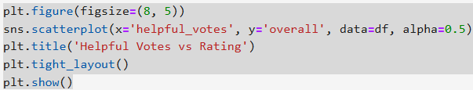
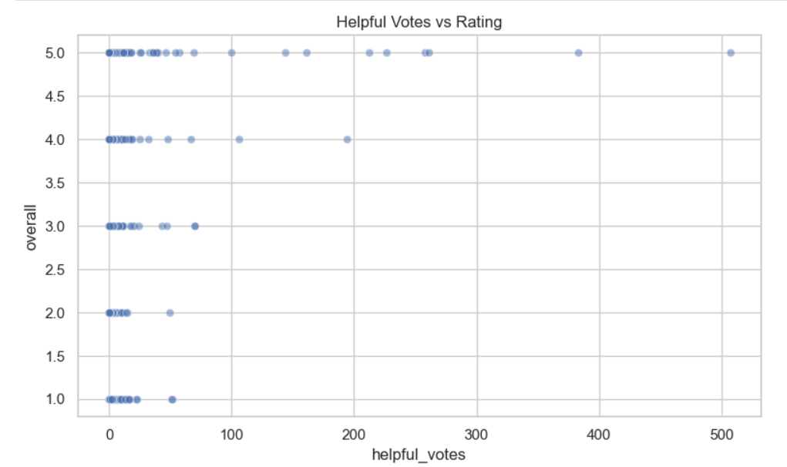
Helpful Votes vs Rating (Scatter)

Slide 6
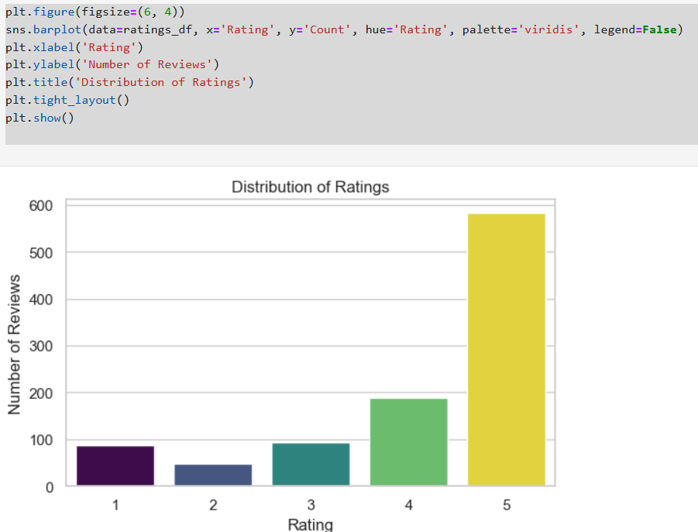
Ratings Distribution (Bar)

Slide 7
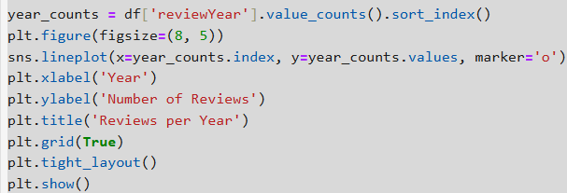
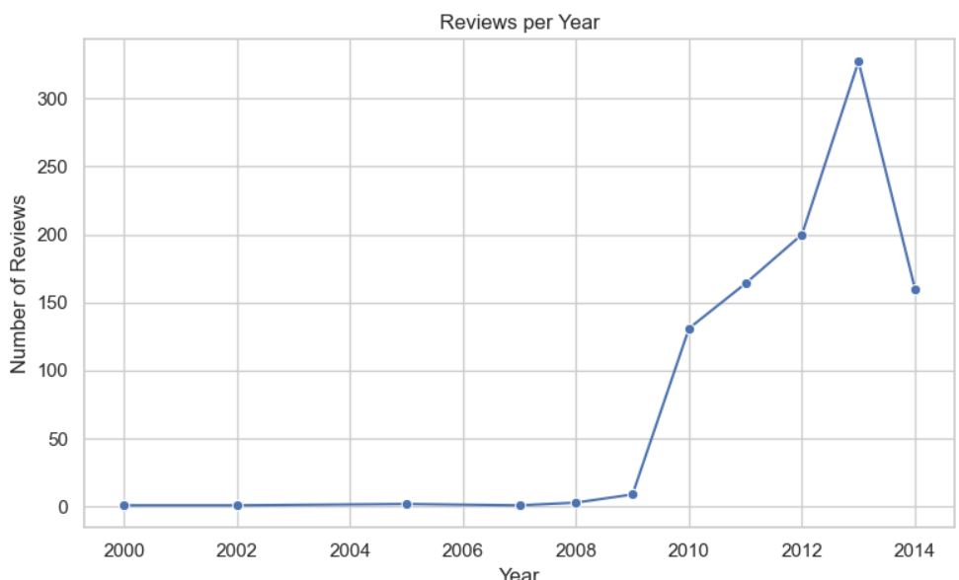
Reviews per Year (Line)

Slide 8
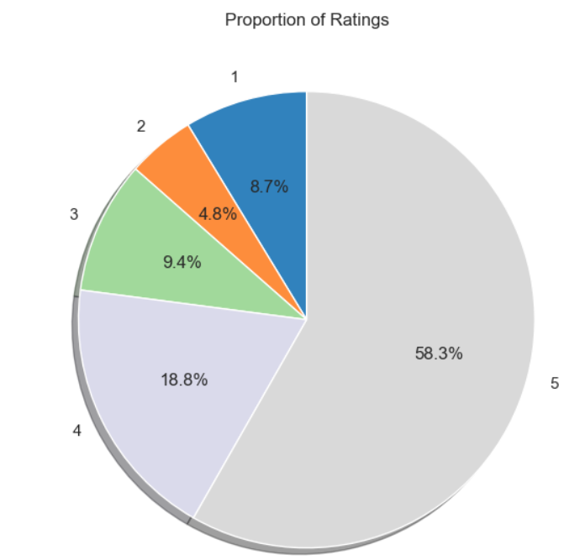
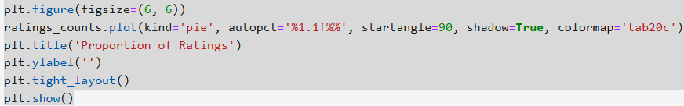
Proportion of Ratings (Pie)

Slide 9
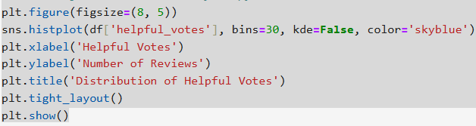
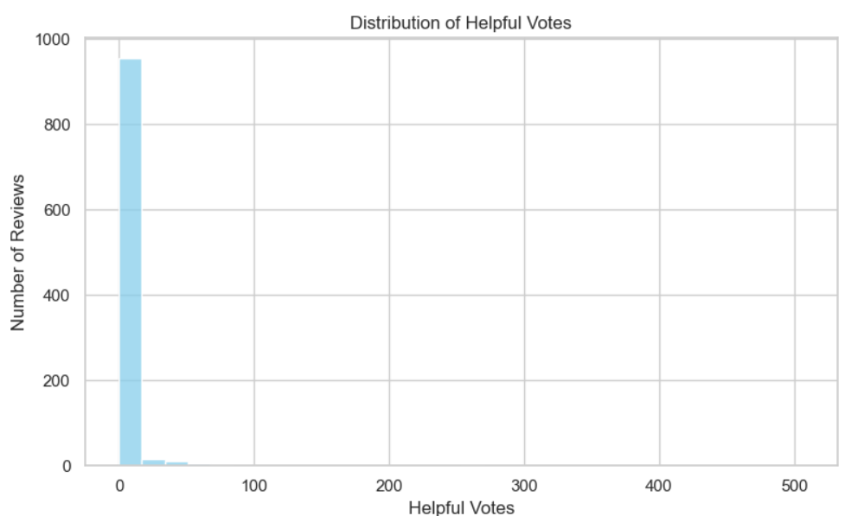
Helpful Votes Distribution (Histogram)

Slide 10
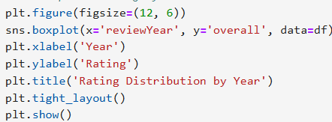
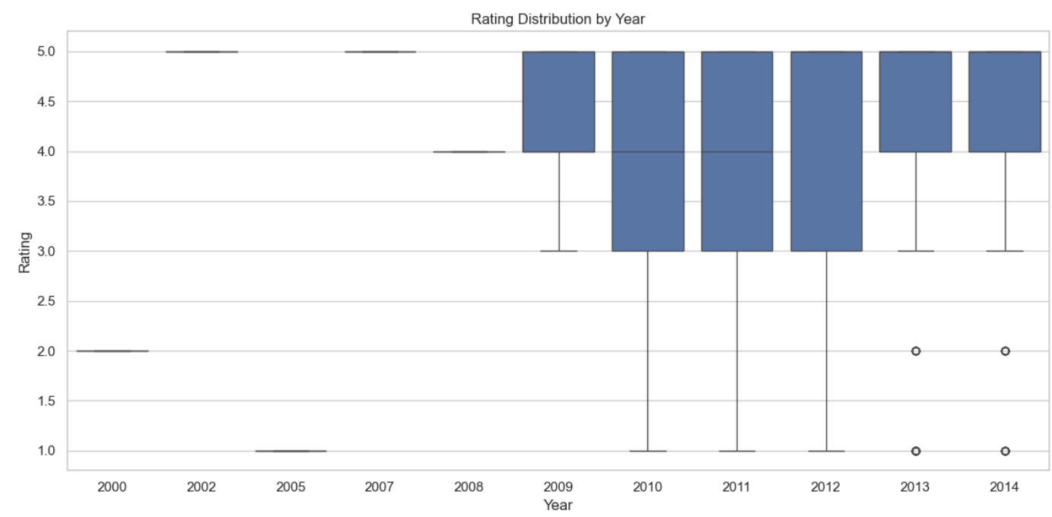
Rating by Year (Box Plot)

Slide 11
CONCLUSION
In this Amazon Product Review Analysis, we explored customer behavior and review patterns using real-time data. The analysis revealed that the average product rating is above 4 stars, indicating that most customers are satisfied with their purchases. The distribution of ratings further confirms that the majority of reviews are 4 or 5 stars. However, the correlation between helpful votes and review ratings is relatively weak, which suggests that the usefulness of a review is not necessarily tied to whether it is positive or negative, but rather how informative it is. Over the years, the number of reviews has steadily increased, reflecting growing user engagement and trust in the platform. Despite this, many reviews still receive few or no helpful votes, possibly due to limited visibility or reader interaction. The analysis also showed that rating patterns have remained fairly consistent year over year, indicating steady customer satisfaction. Additionally, the data was thoroughly cleaned missing values were handled, duplicates removed, and the 'helpful' field was converted into usable numeric columns—making the dataset well-prepared for deeper analysis or predictive modeling. Overall, this analysis provides valuable insights for businesses, marketers, and data scientists aiming to understand user feedback, improve product offerings, and enhance customer experience on e-commerce platforms.

